Slide 1
Design Patterns

Slide 2
What is a pattern?
Patterns = problem/solution pairs in context
Patterns facilitate reuse of successful software architectures and design
Not code reuse
Instead, solution/strategy reuse
Sometimes, interface reuse

Slide 3
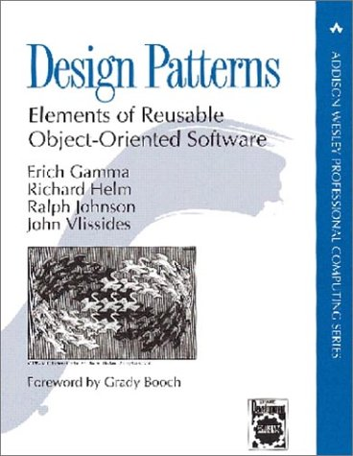
Gang of Four
The book that started it all
Community refers to authors as the “Gang of Four”
Figures and some text in these slides come from book

Slide 4
Object Modeling Technique (OMT)
Used to describe patterns in GO4 book
Graphical representation of OO relationships
Class diagrams show the static relationship between classes
Object diagrams represent the state of a program as series of related objects
Interaction diagrams illustrate execution of the program as an interaction among related objects

Slide 5
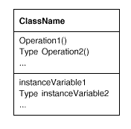
Classes

Slide 6

Object instantiation

Slide 7
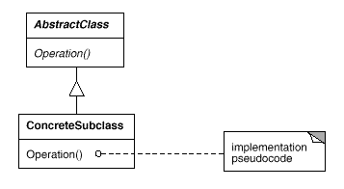
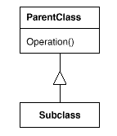
Subclassing and Abstract Classes

Slide 8
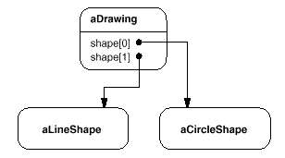
Object diagrams

Slide 9
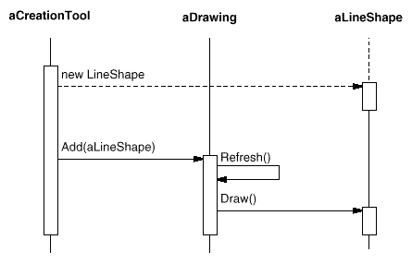
Interaction diagrams
time

Slide 10
Components of a Pattern
Pattern name
identify this pattern; distinguish from other patterns
define terminology
Pattern alias – “also known as”
Real-world example
Context
Problem

Slide 11
Components of a Pattern (cont’d)
Solution
typically natural language notation
Structure
class (and possibly object) diagram in solution
Interaction diagram (optional)
Consequences
advantages and disadvantages of pattern
ways to address residual design decisions

Slide 12
Components of a Pattern (cont’d)
Implementation
critical portion of plausible code for pattern
Known uses
often systems that inspired pattern
References - See also
related patterns that may be applied in similar cases

Slide 13
Design patterns taxonomy
Creational patterns
concern the process of object creation
Structural patterns
deal with the composition of classes or objects
Behavioral patterns
characterize the ways in which classes or objects interact and distribute responsibility.

Slide 14
Creational patterns
Singleton
Ensure a class only has one instance, and provide a global point of access to it.
Typesafe Enum
Generalizes Singleton: ensures a class has a fixed number of unique instances.
Abstract Factory
Provide an interface for creating families of related or dependent objects without specifying their concrete classes.

Slide 15
Structural patterns
Adapter
Convert the interface of a class into another interface clients expect. Adapter lets classes work together that couldn't otherwise because of incompatible interfaces
Proxy
Provide a surrogate or placeholder for another object to control access to it
Decorator
Attach additional responsibilities to an object dynamically

Slide 16
Behavioral patterns
Template
Define the skeleton of an algorithm in an operation, deferring some steps to subclasses
State
Allow an object to alter its behavior when its internal state changes. The object will appear to change its class
Observer
Define a one-to-many dependency between objects so that when one object changes state, all its dependents are notified and updated automatically

Slide 17
Observer Pattern
Defines a “one-to-many” dependency between objects so that when one object changes state, all its dependents are notified and updated automatically
a.k.a Dependence mechanism / publish-subscribe / broadcast / change-update

Slide 18
Observer Pattern
Dependence/publish-subscribe mechanism in programming language o Smalltalk being the first pure Object Oriented language in which observer pattern was used in implementing its Model View Controller (MVC) pattern. It was a publish-subscribe mechanism in which views (GUIs) were linked with their models (containers of information) through controller objects. Therefore, whenever underlying data changes in the model objects, the controller would notify the view objects to refresh themselves and vice versa.
MVC pattern was based on the observer pattern.

Slide 19
Observer pattern
Motivation:
It provides a common side effect of partitioning a system into a collection of cooperating classes that are in the need to maintain consistency between related objects.
Description:
This can be used when multiple displays of state are needed.
Consequences :
Optimizations to enhance display performance are impractical.

Slide 20
Subject & Observer
Subject
the object which will frequently change its state and upon which other objects depend
Observer
the object which depends on a subject and updates according to its subject's state.

Slide 21
Observer Pattern - Example
a
b
c
b
Observers
x
60
30
10
a
c
y
50
30
20
z
80
10
10
a b c
a = 50%
b = 30%
c = 20%
Subject
requests, modifications
change notification

Slide 22
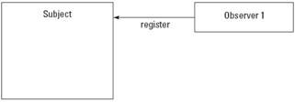
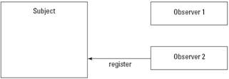
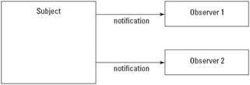
Observer Pattern - Working
A number of Observers “register” to receive notifications of changes to the Subject. Observers are not aware of the presence of each other.
When a certain event or “change” in Subject occurs, all Observers are “notified’.

Slide 23
Observer Pattern - Key Players
Subject
has a list of observers
Interfaces for attaching/detaching an observer
Observer
An updating interface for objects that gets notified of changes in a subject
ConcreteSubject
Stores “state of interest” to observers
Sends notification when state changes
ConcreteObserver
Implements updating interface

Slide 24
Observer Pattern - UML
Subject
observers
Observer
attach (Observer)
Update()
detach (Observer)
For all x in observers{
x.Update(); }
Notify ()
ConcreteObserver
subject
ConcreteSubject
Update()
SetState()
observerState
GetState()
observerState=
subject.getState();
subjectState
Notes:
Attach(): Observer registers itself as a dependent of subject.
Detach(): Observer Unregisters itself as a dependent of subject.
Notify(): Object notifies dependents when information changes by sending itself a #changed message.
Update(): Dependent can define what it does in response to changes by defining the update method.

Slide 25
Observer Pattern - UML
observers
Subject
Observer
Attach(Observer)
Detach(Observer) Notify()
Update()
for all o in
observers {
o -> Update()}
ConcreteObserver
Update()
observerState =
subject->GetState()
subject
ConcreteSubject
observerState
SetState()
GetState()
return subjectState
subjectState
Notes:
Related Patters:
Mediator – an object in the middle intercepts all update requests and broadcasts them to other objects
Singleton – A “single” subject object instance can be implemented with a Singleton
Decorator – an intermediate observer can be viewed as a subject’s decorator
Proxy – observer do not interact directly with subject and can hide the way the subject is acceded

Slide 26
Observer Pattern - Consequences
Loosely Coupled
Reuse subjects without reusing their observers, and vice versa
Add observers without modifying the subject or other observers
Abstract coupling between subject and observer
Concrete class of none of the observers is known
Notes:
Abstract coupling – Subject is not aware of who the observers are.
Some Safeguards:
Mapping subjects to observers (subjects store references)
Have state-setting operations of notifications of updates
- May be expensive and inefficient
Make clients notify of changes at the right time
- Clients have an added responsibility and forget
Dangling references to deleted subjects should be avoided
Subject state should be self-consistent before notification
Avoid observer-specific update protocols
Push – subject sends observers detail at will
Pull – observers ask for detail after notification is sent
Specify modifications of interest explicitly
Encapsulate complex update semantics

